Slide 1
GCC Cyclistic Case Study DatasetAWS
Team Members:
Manasa Avula - 801307493
Nikhita Sai Boyidapu - 801327682
Srikar Chamarthy - 801317299
Rachana Gullipalli - 801311637
Aravind Pabbisetty - 801274519

Slide 2
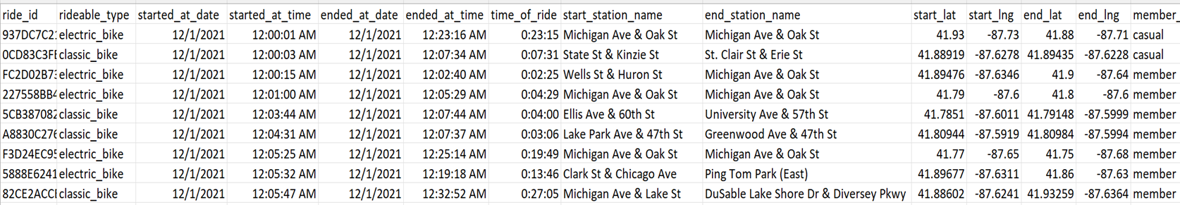
Dataset Description
The dataset consists of information of all the rides taken using different types of bikes by various citizens recently during the period of 12/2021 to 11/2022. The data is stored in CSV files where there is an individual CSV file present for trips taken each month. The dataset consists of attributes such as :

Slide 3
Business Problem and Domain Knowledge
The Cyclistic Bike Share dataset provides us with valuable information about the usage of bikes in the bike-sharing industry. A potential business problem or opportunity that this dataset could be used to address is the optimization of Cyclistic's marketing strategy to attract more riders and increase revenue. There are several factors that can affect bike ridership, including weather conditions, day of the week, and time of day. By analyzing the data, we could identify patterns and trends in rider behavior and preferences, such as the most popular start and end stations, peak riding times, and trip lengths.
This kind of analysis can help bike-sharing companies to make more bikes available during those times. To conduct our analysis, we will be using AWS S3 to store the dataset's CSV files, Amazon Quicksight to create interactive visualizations, and Amazon Sagemaker for data preparation and analysis. By leveraging these powerful AWS tools, we can efficiently extract meaningful insights from the Cyclistic Bike Share dataset to drive business growth and enhance the overall bike-sharing experience.

Slide 4
Research Objectives and Questions
1) Which bike type is most used among the casual , docked and electric bikes?
2) Which weekday is preferable for people to ride the bike?
3) What is the peak time during the weekday that people use the bike?
4) What types of bikes are preferred by different customer types?
5) What is the average time of ride for each bike type?
6) How does the demand for bike rides vary across different months and days of the week based on start date and time?
7) Is there a difference in the duration of rides between members and casual riders?
8) What type of bike is most preferred in the next 5 years?
9) What will be the most demandable locations for the next 3 years?

Slide 5
Data Understanding
The chosen dataset consists of 1200000 records and 19 columns. Some of the Important columns include:
ride_id: It is the unique identifier assigned to each ride taken. rideable_type: It consists of the type of bike used in the ride. start_station_name: It consists of the station name where the ride starts. member_casual: It describes the membership of the customer such as casual_member or member.
There are other columns such as started_at_date, started_at_time, ended_at_date, ended_at_time, time_of_ride, end_station_name, start_lat, start_lng, end_lat, end_lng.
To understand the data we have used dataframe functions such as head(): To view the first five records info(): To view the information about the columns describe(): Gives a statistical description of the attributes shape(): To find the number of rows and columns in the dataframe.

Slide 6
Data Preparation
Data Preparation is an important task when working with Big Data. To prepare the data we have the jupyter notebook in AWS SageMaker. While performing the data preparation we have done: Dropping unnamed columns and checking columns having null values
Replacing null values with mode value of respective columns and checking is still null values exists
Dropping the Duplicate rows.
Adding a new column rideable_type_value that stores the categorical variable (rideable_type) as a numeric value.
Adding a new column weekday for the started date.

Slide 7
Exploratory Data Analysis:
We have done exploratory data analysis for our dataset with the help of jupyter notebook provided by AWS SageMaker. We have done various analysis such as finding skew of numeric columns, word cloud for most visited destination, rides taken each day of the week, correlation between longitude, distribution of bike types.
This analysis helped us to understand and find patterns within the dataset, outlier detection and identify interesting correlations among the columns.

Slide 8
AWS Services Used
S3
Sagemaker
Quicksight

Slide 9
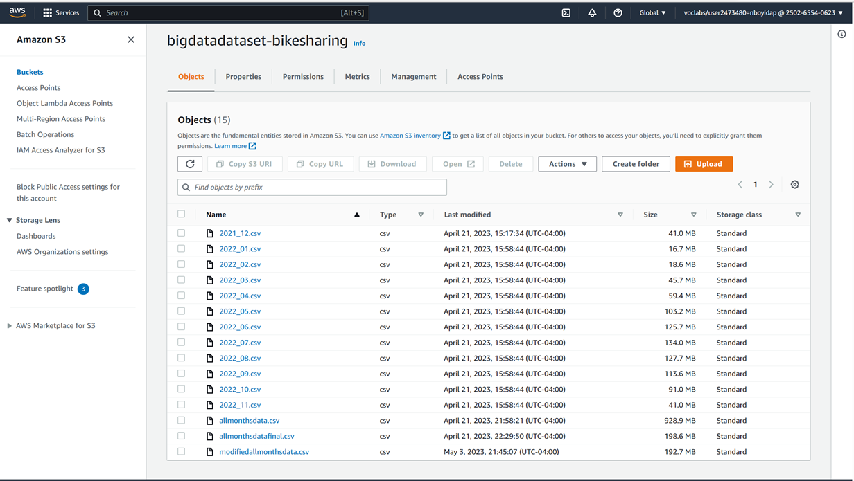
S3
We have used S3 to create a bucket and store csv files of each month and also stored the combined csv file of all months.

Slide 10
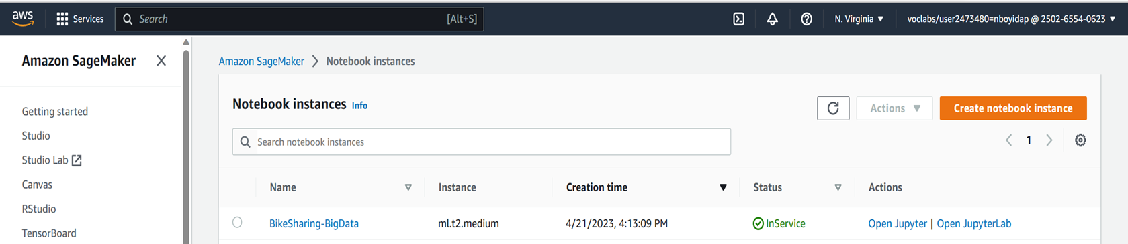
Sagemaker
We have used the jupyter notebook in sagemaker for the data preparation and analysis.

Slide 11
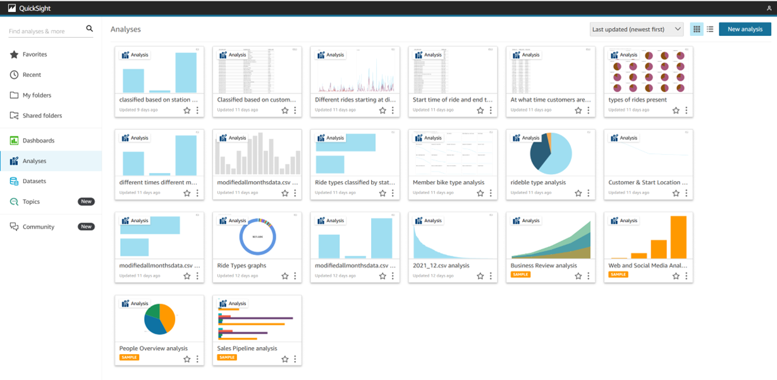
QuickSight
We have used quicksight to create a dashboard of the data visualizations.

Slide 12
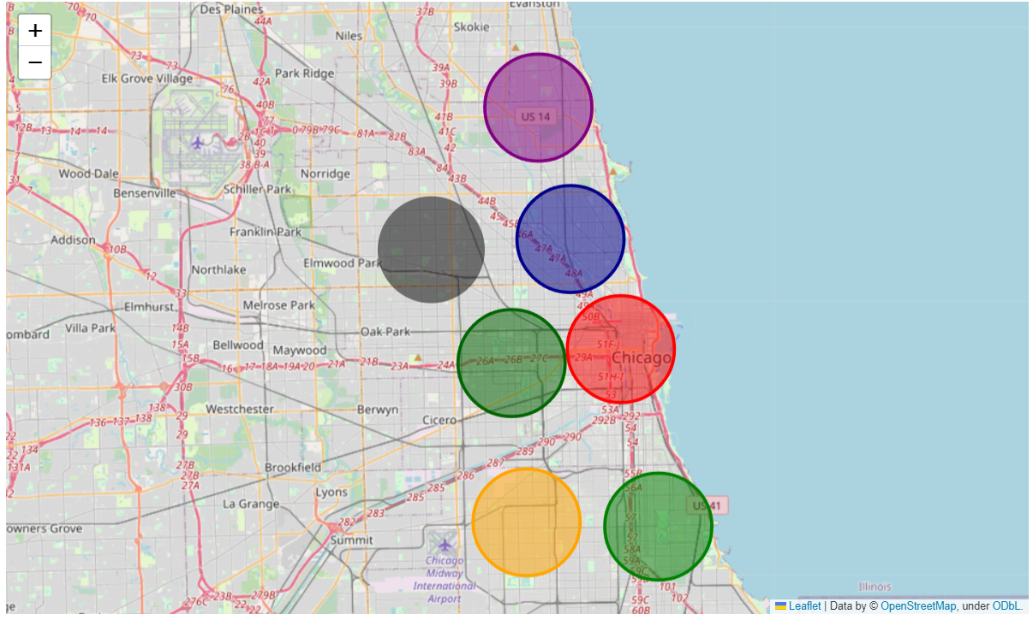
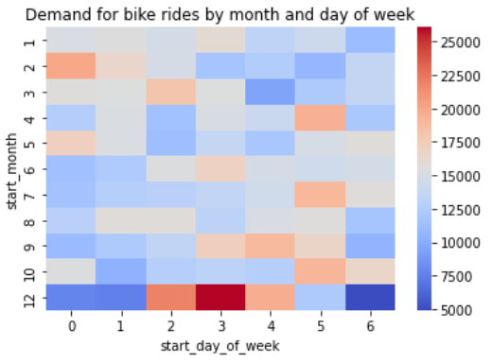
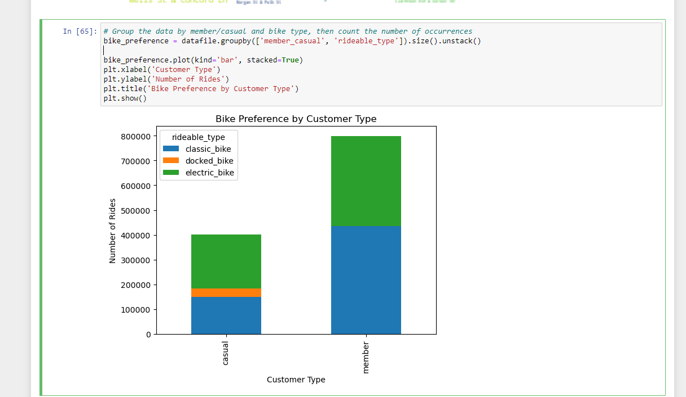
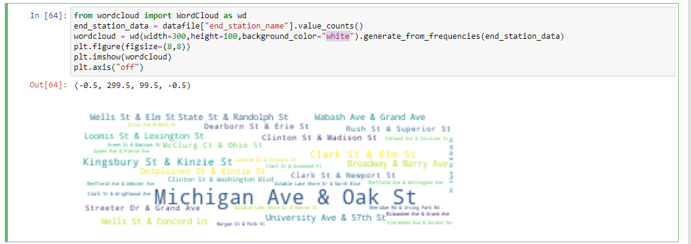
Results
Fig(1): Most demandable location in next few years Fig(2): Demand for bikes by each month and day of week
Fig(3): Types of bikes are preferred by different customer types Fig(4): Most used end station for returning the bike.

Slide 13
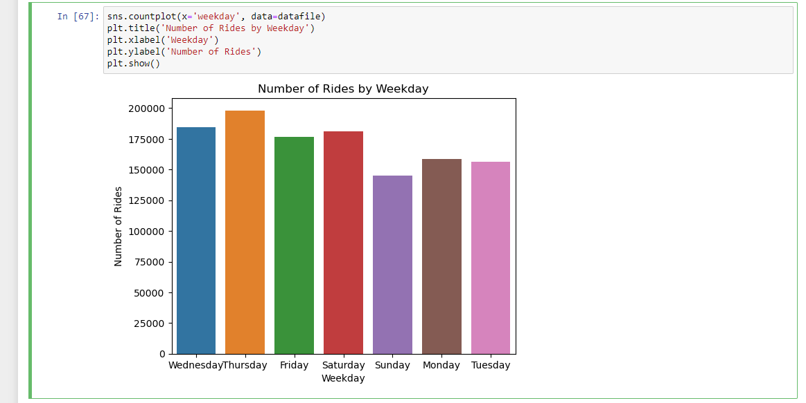
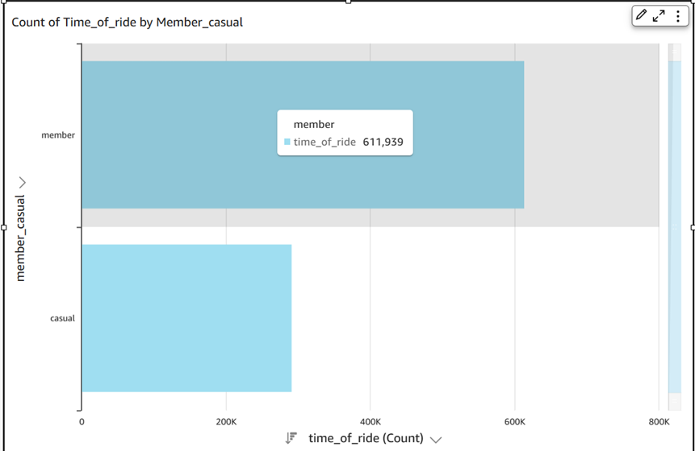
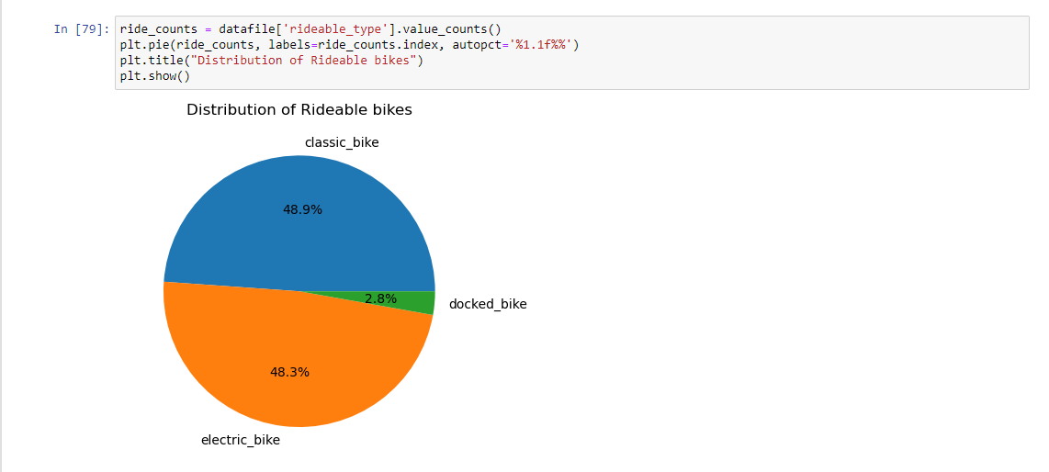
Results
Fig(5): Weekday preferable for people to ride the bike Fig(6): Duration of rides between members and casual riders.
Fig(7): Bike type mostly used

Slide 14
Future Work and Comments
In the future we would like to optimize the model, improve its performance, accuracy and derive many other useful insights and predictions that will be useful for the bike sharing organization while making decisions. So that they can provide much better services to its customers and stand ahead of their competitors.

Slide 15
Thank You

